Slide 1
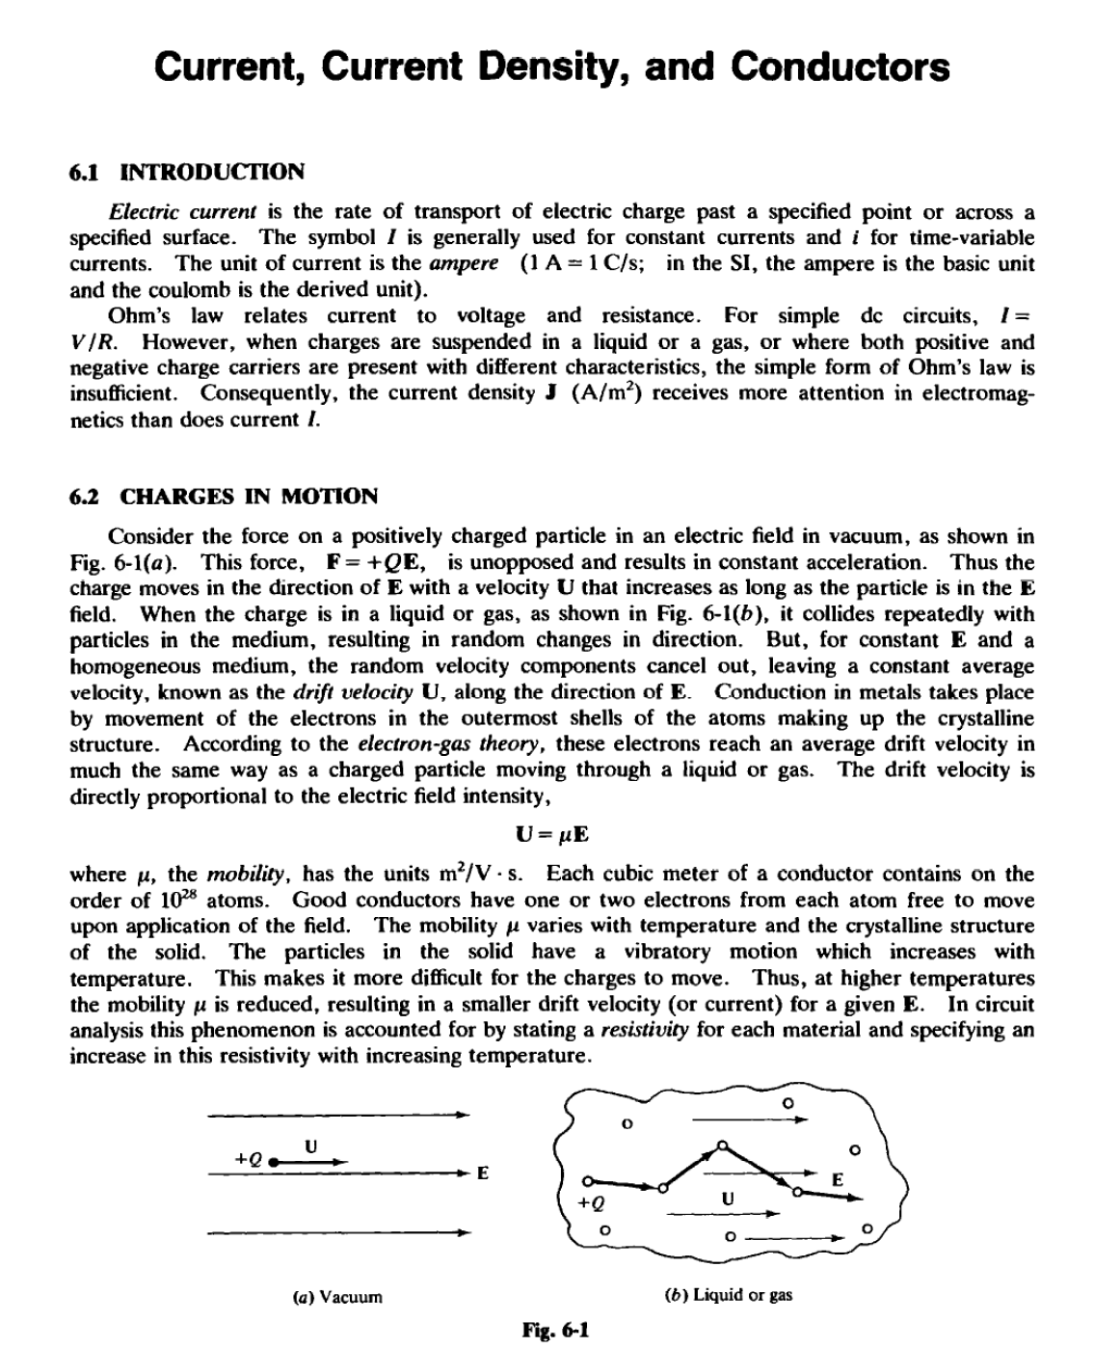
Lecture six

Slide 2
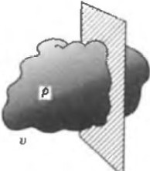
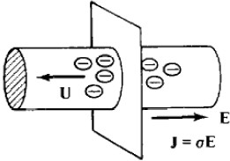
Lecture six
6.3 CONVECTION CURRENT DENSITY J
A set of charged particles giving rise to a charge density p in a volum e v is shown in Fig. 6-2 to have a velocity U to the right. The particles arc assumed to maint ain their relative positions within the volume. As this charge configuration passes a surface S it constitutes a convection current, with density
J "" pU (A/m²
)
Of course, if the cross section of v varies or if the density p is not constant throughout v, then J will not be constant with time. Further, J will be zero when the last portion of the volume crosses
S. Nevertheless, the concept of a current density caused by a cloud of charged panicles in motion is
at times useful in the study of electromagnetic field theory.
-
s
Fig. 6-2
u
J = pU
6.4 CONDUCfiON CURRENT DENSITY J
Of more interest is the conduction current that occurs in the presence of an electric field within a conductor of fixed cross section. The current density is again given by
J = pU (A/ m²
)
which, in view of the relation U =J,LE, can be written
J = aE
where a =Pll is the conductivity of the material, in siemens p er meter (S/ m). In metallic conductors the charge carriers are electrons, which drift in a direction opposite to that of the electric field (Fig. 6-3). Hence, for electrons, both p and p. are negative, which results in a positive conductivity a, ju st as in the case of positive charge carriers. It follows that J and E have the same direction regardless of the sign of the charge carriers. It is conventional to treat electrons moving to the left as positive charges moving to the right , and always to report p and p. as positive.
The relation J = aE is often referred to as the p oint f orm of Ohm'slaw. The factor a takes
into account the density of the electrons free to move (p) and the relative ease with which they move
through the crystalline structure (p.). As might be expected, a is a function of temperature.
s
Fig.6-3

Slide 3
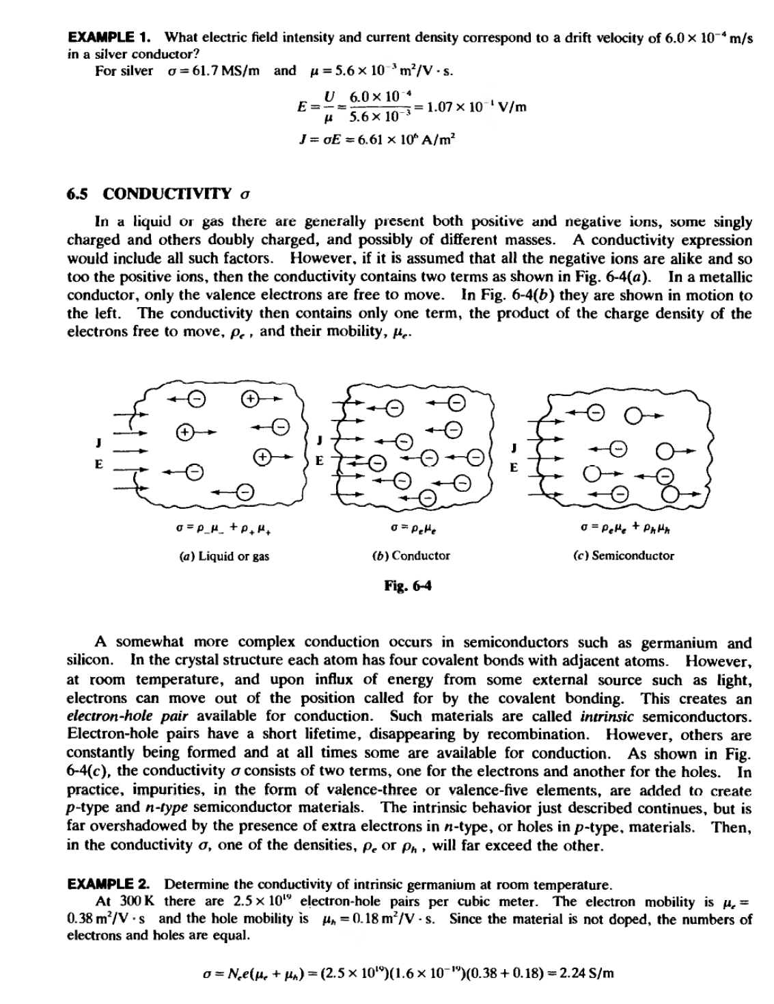
Lecture six

Slide 4
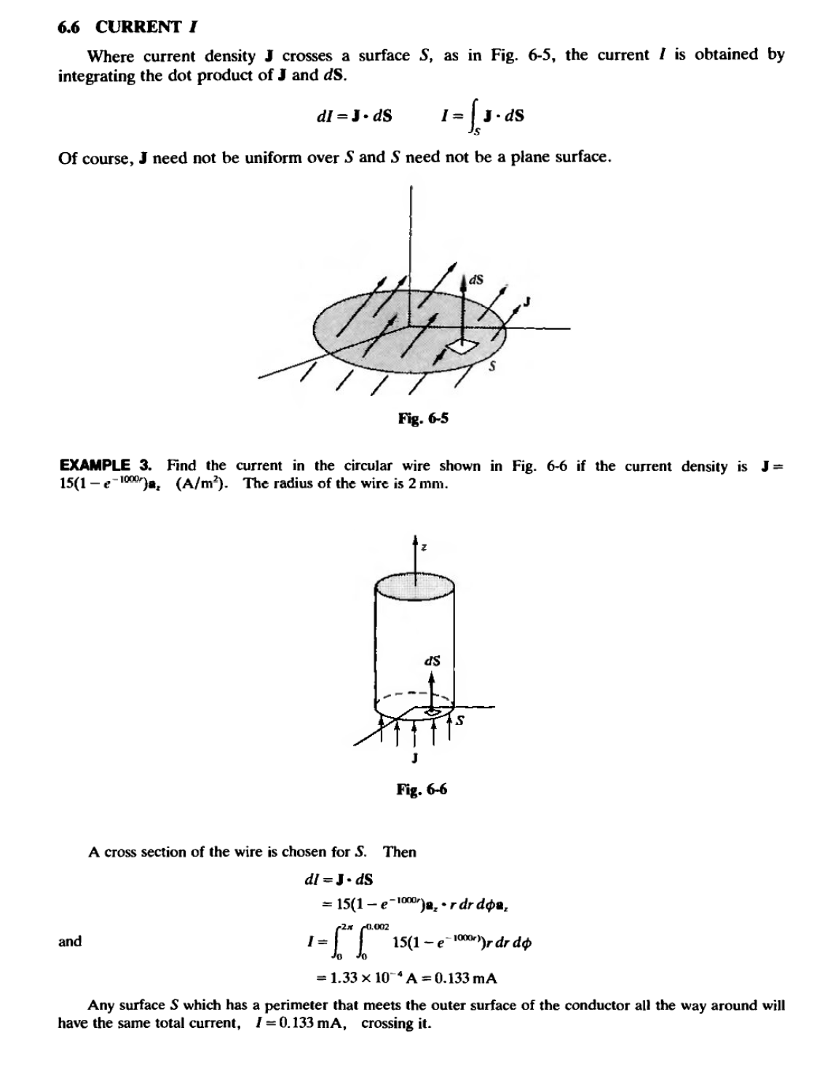
Lecture six

Slide 5
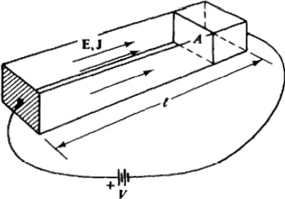
Lecture six
6.7 RESISTANCE R
If a conductor of uniform cross-sectional area A and length t,as shown in Fig. 6-7. has a voltage
difference V between its ends, then
E=­^{v} and J =^{oV} t t­
assuming that the current is uniformly distributed over the area A The total current is then
I =JA = oAV
t
Since Ohm's law states that V = IR, the resistance is
t
R =oA (0)
(Note that 1s-• = I0; the siemens was formerly known as the mho.) This expression for resistance is generally applied to all conductors where the cross section remains constant over the length t. However. if the current density is greater along the surface area of the conductor than in the center, then the expression is not valid. For such nonuniform current distributions the resistance is given by
v v
=---
R=
J J • dS IoE • dS
If E is known rather than the voltage difference between the two faces, the resistance is given by
IE·dl
f oE·dS
The numerator gives the voltage drop across the sample, while the denominator gives the total
current I.
R =----
fla.6-7
EXAMPLE •· Find the resistance between the inner and outer curved surfaces of the block shown in Fig. 6-8,
where the material is silver for which o = 6.17 x 10⁷ S/m.
If the same current I crosses both the inner and outer curved surfaces,
k k
J =-a.
T
and E=--.
or

Slide 6
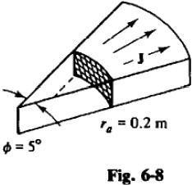
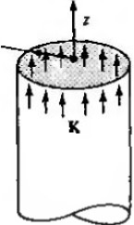
Lecture six
-r
J-O.OSm
'b • 3.0m
Then (5" = 0.0873 rad),
to a,·dra,
r(BfiXm;.,.rd4>dza,
o(O.OS)(O.os₇₃) 1.01 x w-'a = 10.1,.,0
R = Jo.l or
In 15
6.8 CURRENT SHEET DENSITY K
At times current is confined to the surface of a conductor, such as the inside walls of a waveguide. For such a current sheet it is helpful to define the density vector K (in A/m), which gives the rate of charge transport per unit transverse length. (Some books use the notation J•.) Figure 6-9 shows a total current of /, in the form of a cylindrical sheet of radius r, flowing in the positive z direction. In this case,
I
K = -•
1Jrr •
at each point of the sheet. For other sheets, K might vary from point to point .
,
In general , the current flowing through a contour C within a current sheet is obtained by integrating the normal component of K along the contour.
I= LK,.dt
EXAMPLE 5. A thin conducting sheet lies in the z '"' 0 plane for 0<x <0.05 m. An a, directed current of 25 A is sinusoidally distributed across the sheet, with linear density zero for x =0 and x =0.05 m and maximum at x =0.025 m (see fig.6-10). Obtain an expression forK.

